Slide 1
Employee Data Analysis using Excel
STUDENT NAME: JERLIN GRAZE. P
REGISTER NO: 312208950 &
asunm135122/c/02
DEPARTMENT: B.Com (General)
COLLEGE : Chevalier T. Thomas Elizabeth College
For Womens

Slide 2
PROJECT TITLE:
Employee Performance Analysis using Excel

Slide 3


AGENDA:
Problem Statement
Project Overview
End Users
Our Solution and Proposition
Dataset Description
Modelling Approach
Results and Discussion
Conclusion
3/21/2024 Annual Review

Slide 4

PROBLEM STATEMENT:
Objective: To analyze employee performance data to identify high performers, areas for improvement, and overall trends within the organization.
Background: The company has collected performance data for its employees over the past year, including metrics such as productivity, attendance, goal achievement, and feedback scores. This data is stored in Excel spreadsheets.

Slide 5

PROJECT OVERVIEW:
To create a comprehensive Excel-based dashboard to analyze and visualize employee performance data, enabling HR and management to make data-driven decisions.

Slide 6

WHO ARE THE END USERS?
Human Resources (HR) Professionals
and Management.
2. Executive Officers and Seniors
3. Managers and Team Leaders

Slide 7

OUR SOLUTION AND ITS VALUE PROPOSITION
Our solution utilizes Excel for employee performance analysis, offering in-depth insights into productivity and efficiency.
The value proposition includes empowering decision-makers with data-driven insights for resource optimization and performance enhancement.
The solution streamlines performance evaluation, facilitates informed decision-making, and drives continuous improvement within the organization.

Slide 8
Dataset Description:
• We took the employee datas from kaggle website.
• We have 26 features totally.But, We used only 9 of the features.
• We entered the name of the employees in Alphabetical order. And we also entered the employee type in Alphabetical order.
• We entered the performance level of the employee in Numerical value.
• We entered the gender of the employees as Male/Female.
• We entered the data of employee rating in Numerical value.
• We entered the Business unit in Alphabetical order.

Slide 9

The "WOW" in our solution:
PERFORMANCE LEVEL =IFS(Z8>=5,”VERY
HIGH”,Z8>=4,”HIGH”,Z8>=3,”MED”,TRUE,”LOW”)
3/21/2024 Annual Review
9

Slide 10
MODELLING APPROACH:
Data Collection: Gather relevant data on employee performance. This might include metrics such as sales figures, project completion rates, attendance, peer reviews, etc.
Data Organization: Enter this data into an Excel spreadsheet. You might have columns for Employee ID, Name, Department, Performance Metrics (e.g., Sales, Hours Worked), and any other relevant factors.
Define Metrics: Identify and define the performance metrics you want to analyze. Common metrics include productivity, quality of work, punctuality, and team collaboration.
10

Slide 11
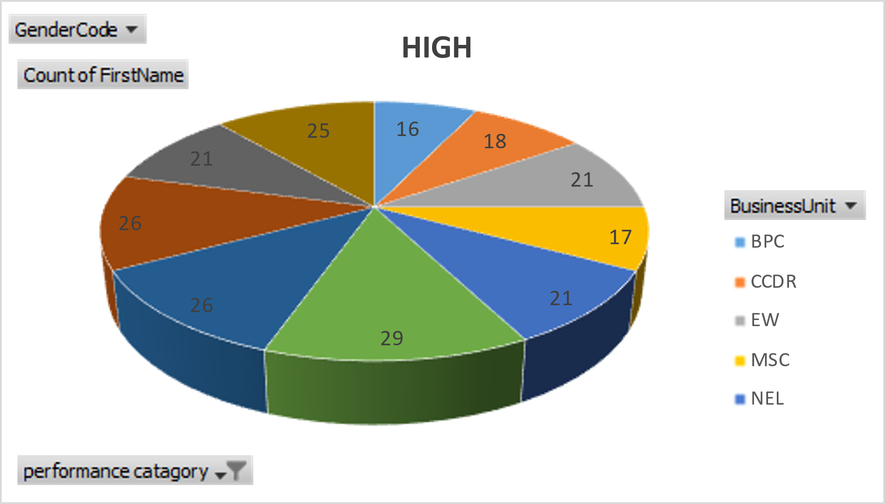
Results:
11

Slide 12
Conclusion:
To conclude the analysis of the employee performance database, we have successfully identified key performance metrics and trends that directly influence overall productivity. By leveraging data-driven insights, we were able to pinpoint areas for improvement, recognize high-performing individuals, and address potential performance issues.The analysis provided actionable insights into factors like attendance, productivity, and employee engagement, which can be further utilized to tailor development programs, optimize resource allocation, and enhance workforce management strategies.

